Slide 1
INFO7374 - Digital Marketing and Analytics Assignment 1 – Team 9 Team Members -Suhas balanagar -Ankita brahmankar -Ankita moharir

Slide 2



Slide 4
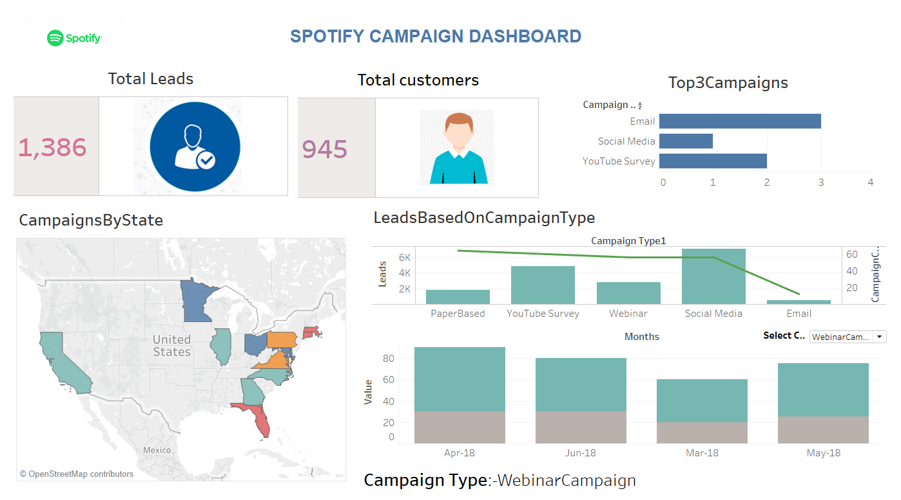

Slide 5
Spotify Campaign Dashboard
Major KPIs determined after product campaign
Total Leads : Gives us the total leads obtained from different campaigns
Total Customers : Customers generated based on leads to customers.
Top 3 Campaigns : Bar graph displaying top most successful campaigns
Reasons for describing above KPIs
Campaigns By State : Most Campaigns run in different states
Leads based on campaign type : Leads and campaign type depicted based on campaign count
Leads to customer ratio per month: A dynamic graph which depicts the leads and values based on different campaign type selected

Slide 6
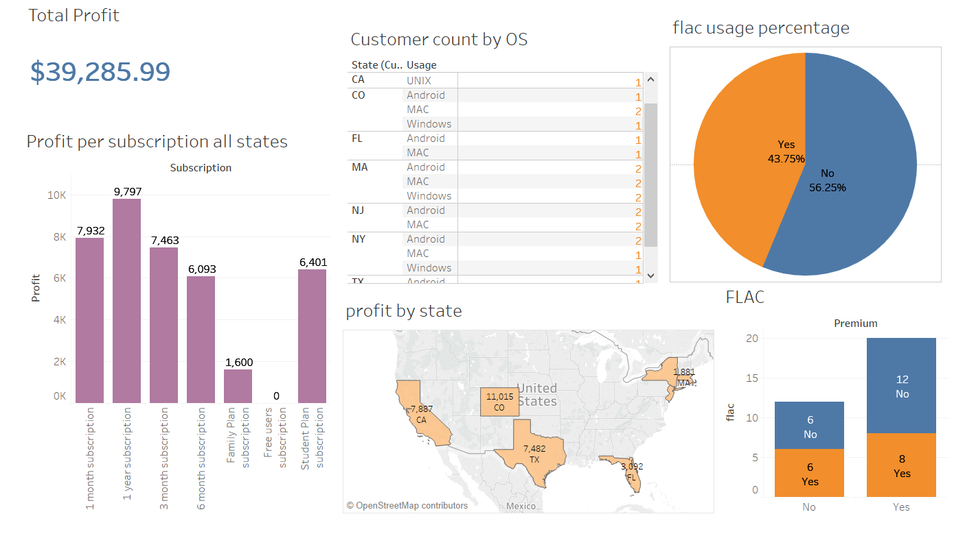

Slide 7
Spotify Customer Dashboard
Total Profit: Profit obtained from all the spotify customers
Profit per subscription for all states : Based on the subscription type the profits obtained statewise
Customer count by OS : Number of customers count based on OS type
Profit by state : Depicts the statewise profits
Flac usage percentage : Illustrates the percentage of flac based spotify users
Flac usage based on premium and trial based users

Slide 8
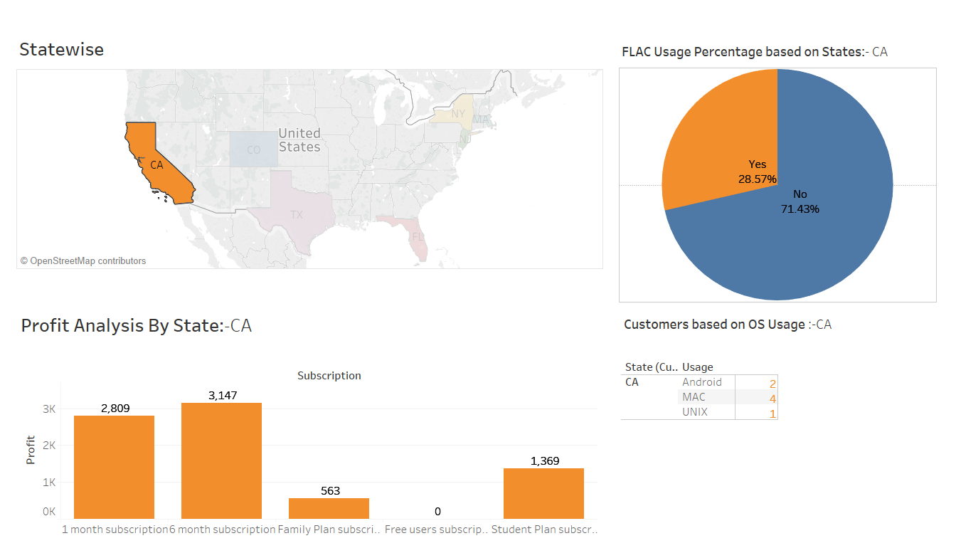

Slide 9
Spotify Statewise Dashboard
In this dashboard
Statewise dynamic selection which gives us the profit, OS usage and flac usage percentage analysis
Profit Analysis by State : Based on the selected state the profits gained in each subscription
FLAC Usage percentage based on States : Shows the state wise percentage of flac usage
Customers based on OS Usage : The total number of customers using spotify on OS

Slide 10
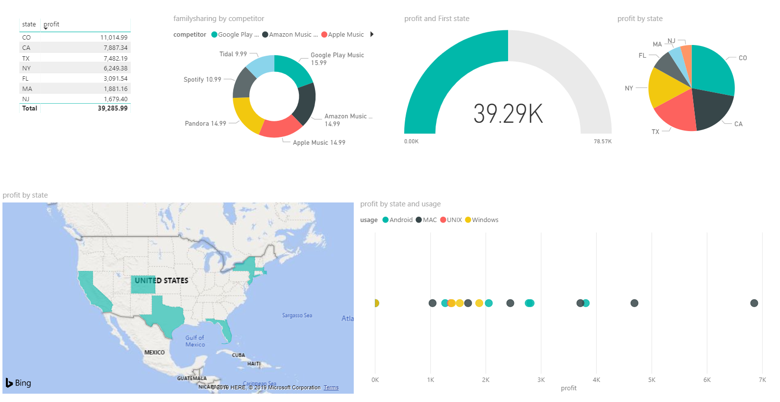

Slide 11
Spotify Competitors Dashboard
Statewise profit
Familysharing by competitors : A donut graph that represents the familysharing subscription price for all the competitors
Profit : Profit for each state based on state selection
Profit by state : A pie chart that depicts profit share statewise
A map that has the states to select from

